Slide 1
QUANTUM MACHINE LEARNING
Anishkumar Dhamelia

Slide 2

BASE IDEA
The goal is to combine the two most ambitious fields in computer science today. Quantum computing and Machin Learning.
One is capable of processing large data and the other requires continuous computation over big data.

Slide 3


Basics of Quantum Computing
Superposition
Qubits
Quantum Gates

Slide 4
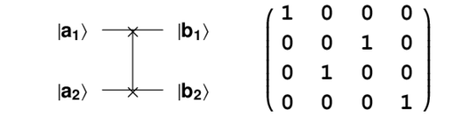

SWAP GATE
This is a 2 Qubit Gate.
It Swaps the state of the Qubits with each other.

Slide 5
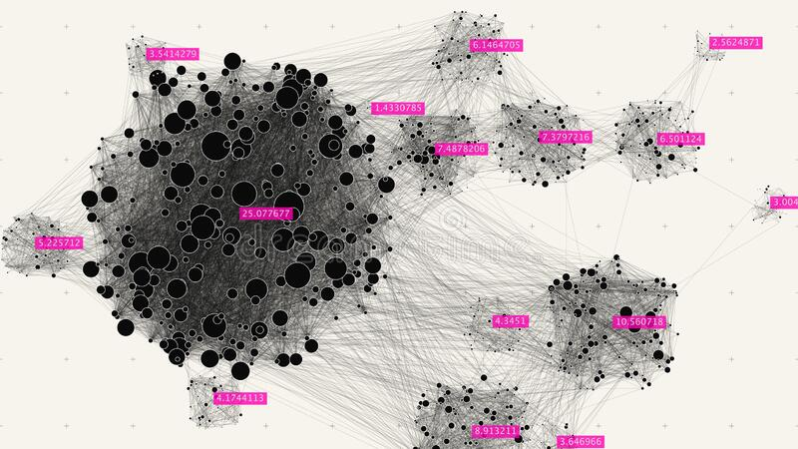
Basics of Machine Learning K-means Clustering:
Categorizes the data into a number of groups as K
Choose K points arbitrarily, as centers of clusters.
Distribute the points to their nearest cluster center, conforming to the Euclidean distance function.
Compute the mean or centroid of the entire objects within each cluster.
Iterate steps 2, 3 and 4 up until the matching points are allocated to each cluster in continuous rounds.

Slide 6
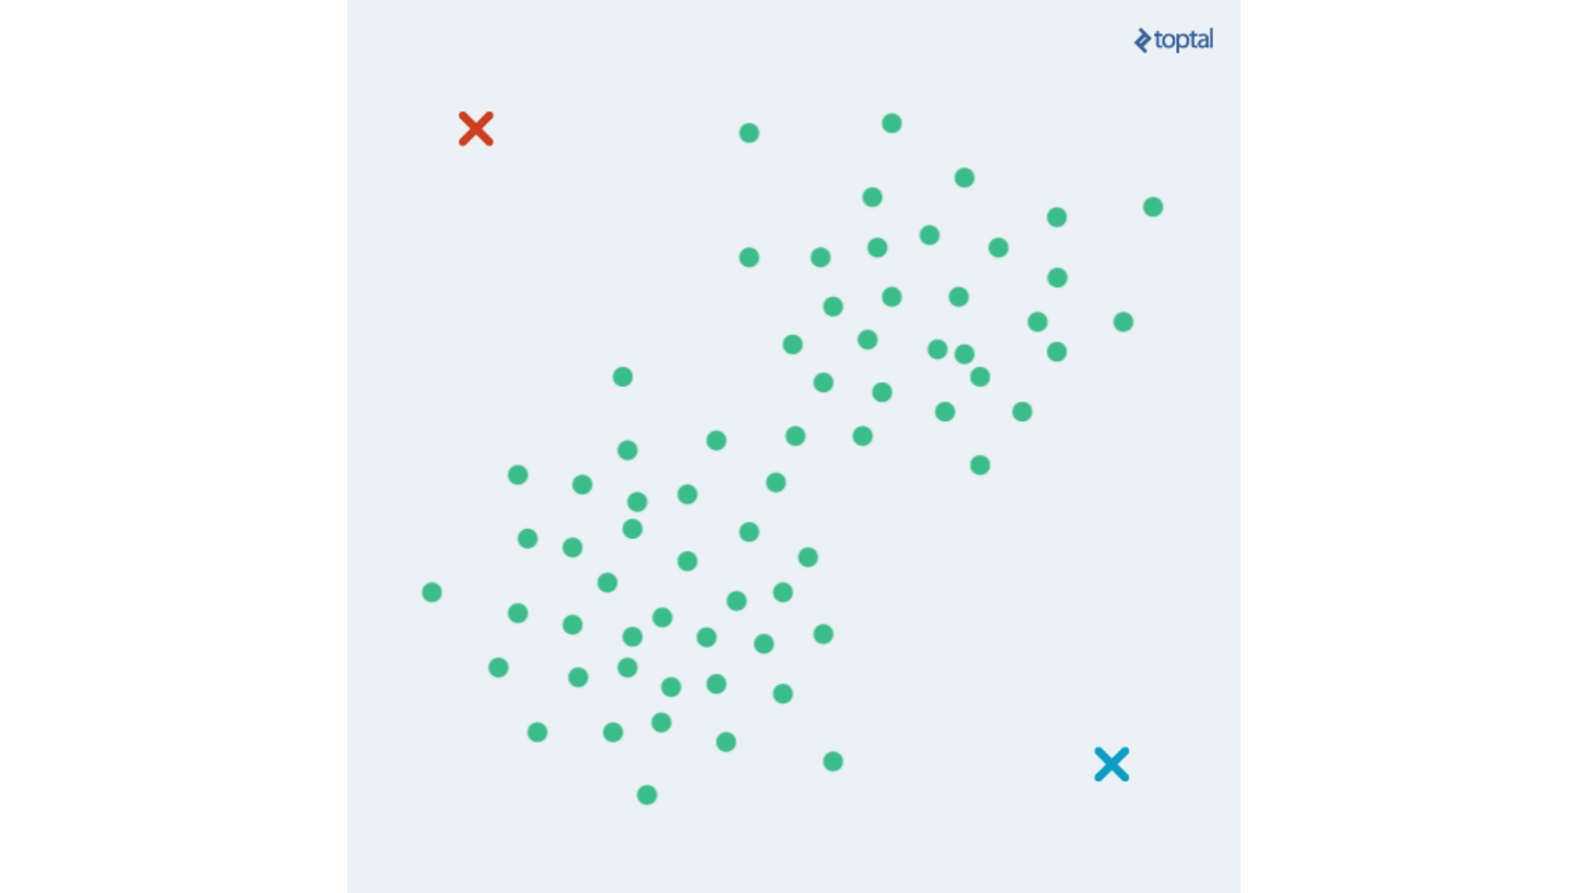
Simulation of K-means Clustering

Slide 7
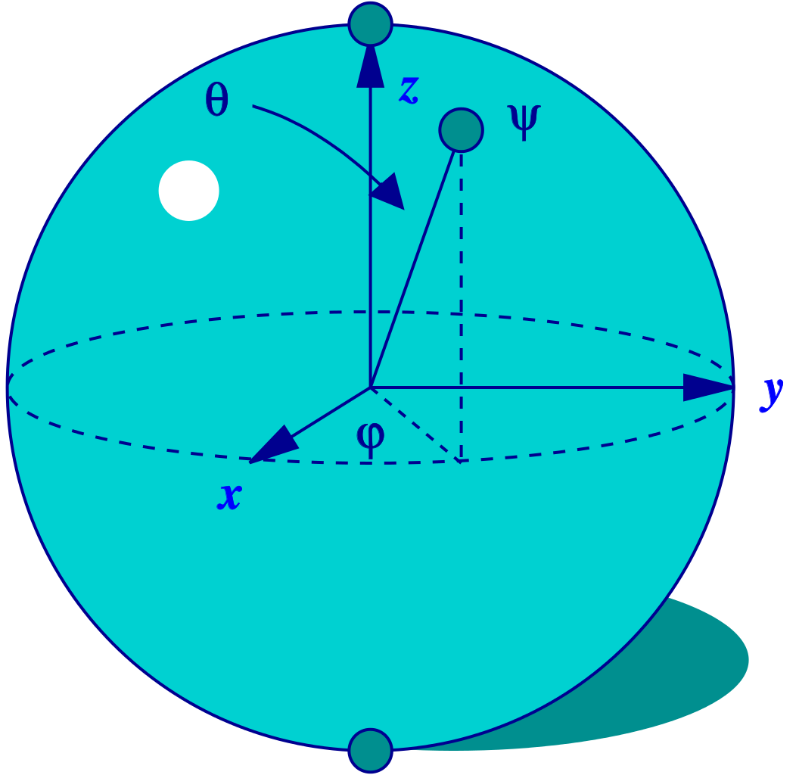
Converting Classical ML to Quantum ML:
?
?
?
?
?
?

Slide 8
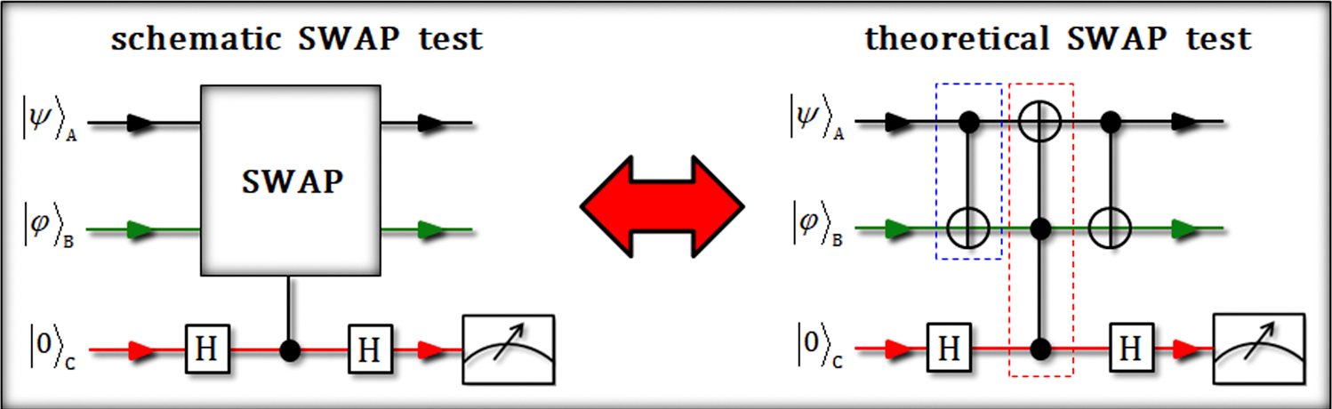
SWAP TEST
It measures the difference between the 2 Qubits
This difference is called Fidelity. It is the probability that the qubits are the same.
When Fidelity is 1 the Qubits have the same state.

Slide 9
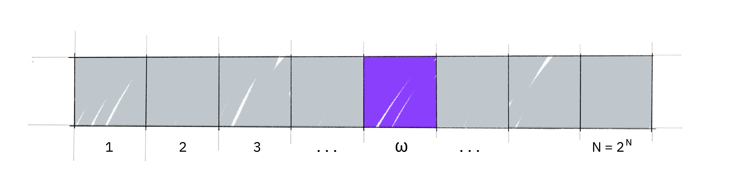

Quantum Minimization Algorithm (QMA)
Grover’s Search Algorithm
Suppose you are given a large list of N items. Among these items there is one item with a unique property that we wish to locate; we will call this one the winner w. Think of each item in the list as a box of a particular color. Say all items in the list are gray except the winner w, which is purple.
To find the purple box -- the marked item -- using classical computation, one would have to check on average N/2 of these boxes, and in the worst case, all N of them. On a quantum computer, however, we can find the marked item in roughly √N steps with Grover's amplitude amplification trick.

Slide 10

QMA Process
1 | 2 | 3 | 4
Take a random index as the current minimum. | Use Grover’s search algorithm to find a marked index. | Make this the new minimum. | If the number of marked states is < 1 end. Else go back to step 2.
SUCCESS

Slide 11

Finally:
SWAP TEST
QUANTUM K-MEANS ALGO.
QMA

Slide 12
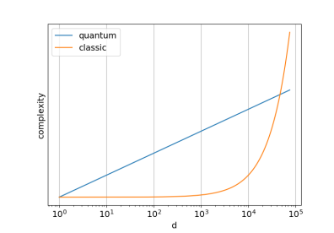
Important Remark
This graph is based on D ( dimensions) and Complexity.
Classical Algorithm’s complexity increases exponentially.
For a small space dimension it could be advisable to use classical algorithm

Slide 13
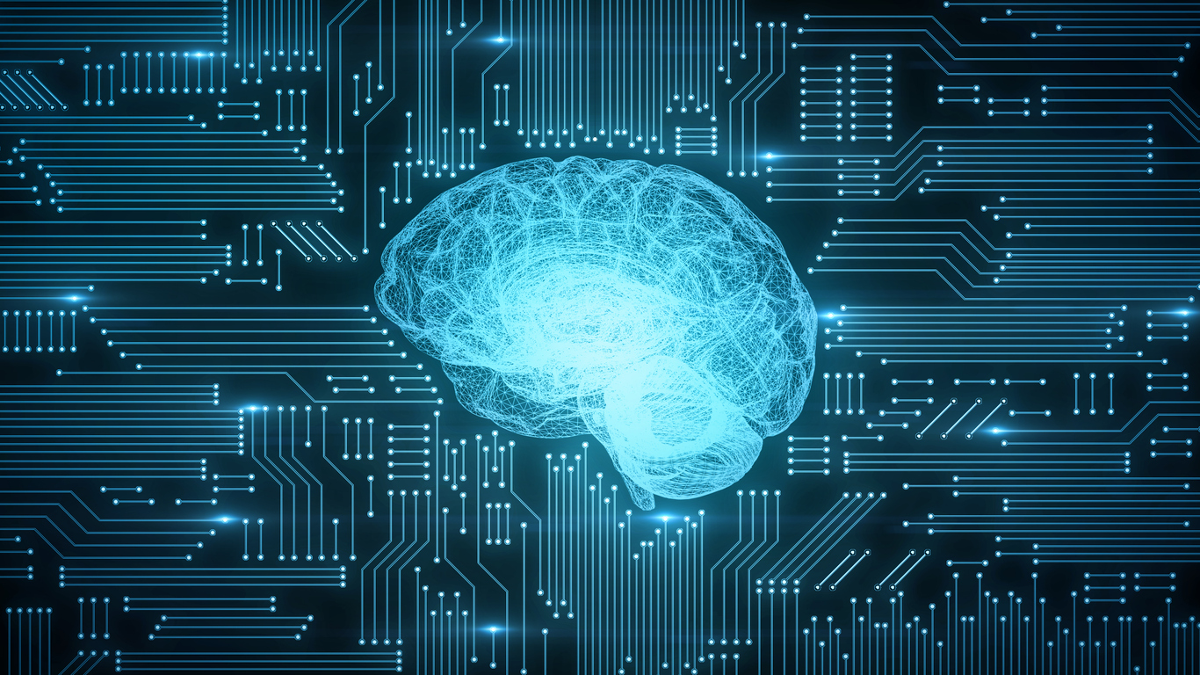
Conclusion:
|
This is not a complete review of QML. But, it showcases the power of using them over classical algorithms
||
Quantum Algorithms have better accuracy than classical algorithms for high dimensional problems.
|||
Even though we were able to replicate K-means Clustering. In the future we may see QML algorithms that can only work on Quantum computers.

Slide 14
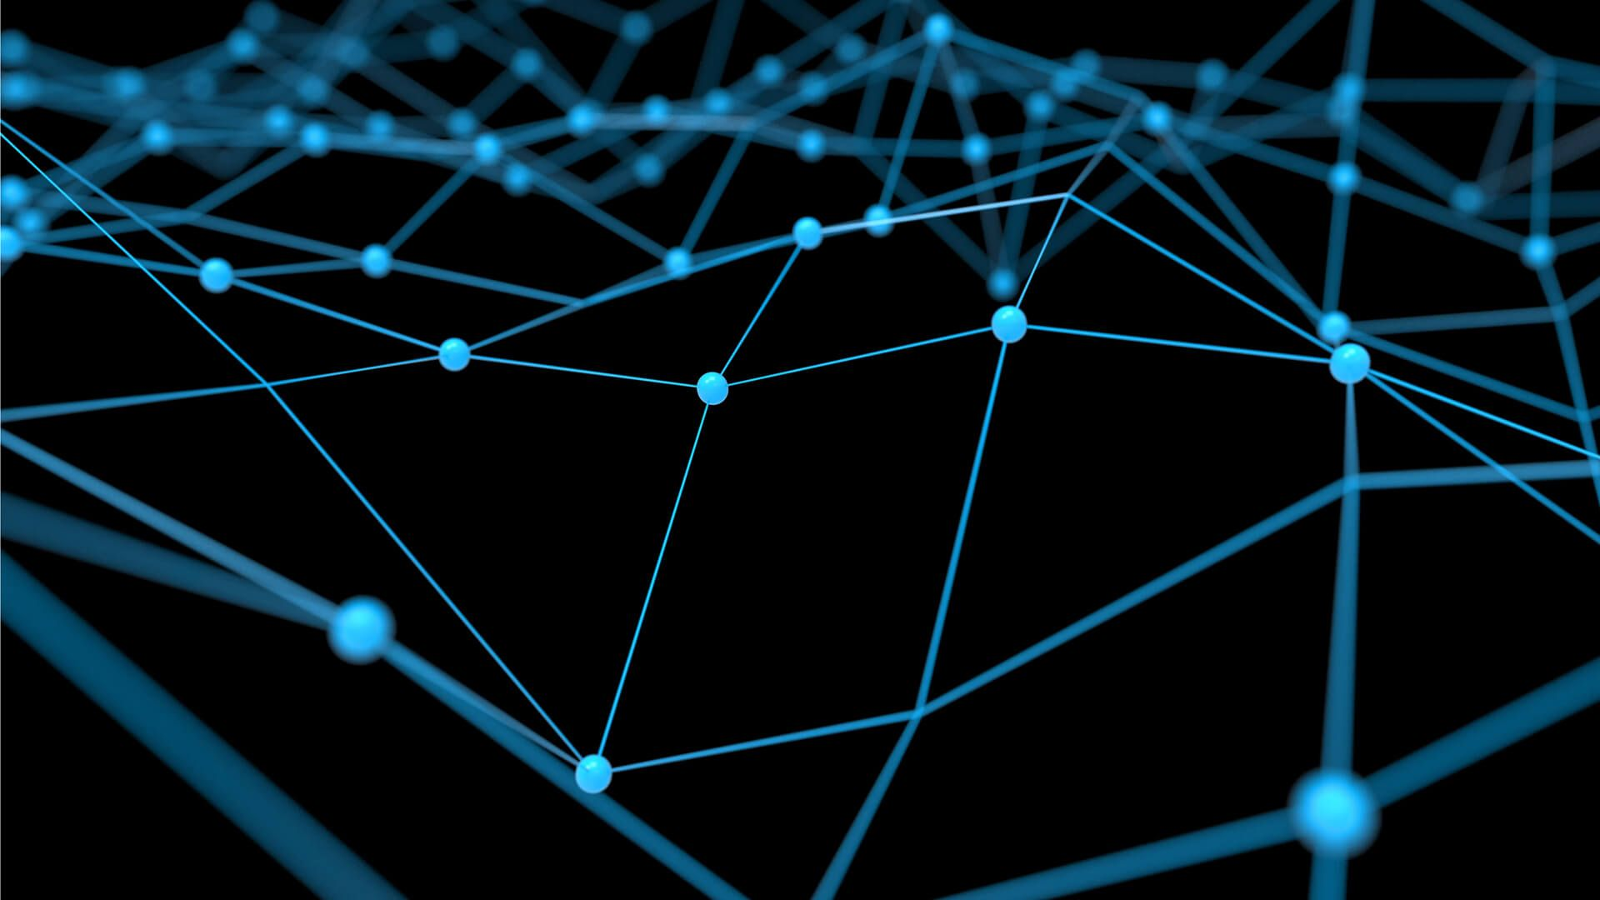
THANK YOU!

